Slide 1
Disorders of lipid metabolism
By
Dr.Qutaiba A. Qasim
PhD. Clinical Biochemistry
2020

Slide 2
Definition of lipids
Lipids are defined as organic compounds that are poorly soluble in water but miscible in organic solvents.
Lipidology is the study of abnormal lipid Metabolism.
An understanding of the pathophysiology of plasma lipid metabolism is usefully based on the concept of lipoproteins, the form in which lipids circulate in plasma.

Slide 3
Biological functions of lipids
Storage of energy
Cell membrane formation
Prostaglandin precursors
Bile acids , steroidal hormones, vit.D presursors (cholesterol)
Chemical messengers
Maintenance of body temperature

Slide 4
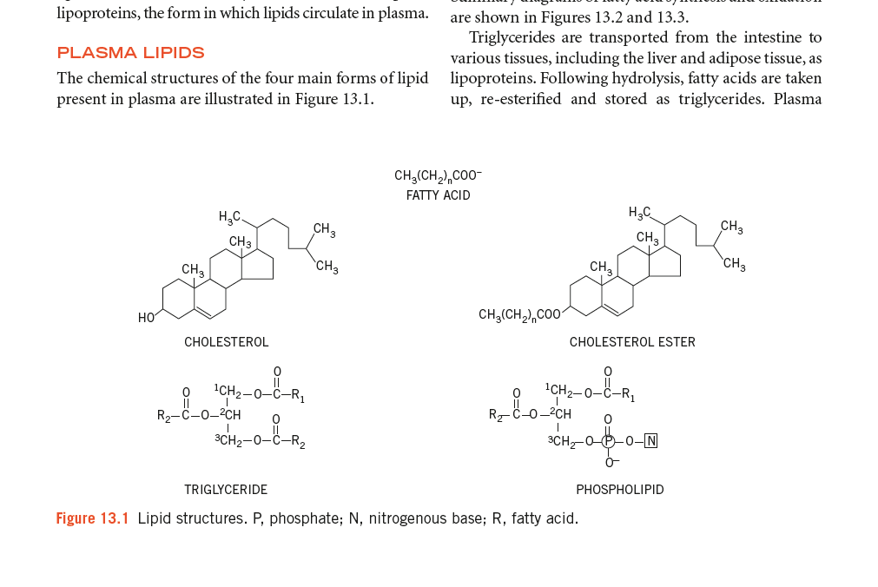

Slide 5
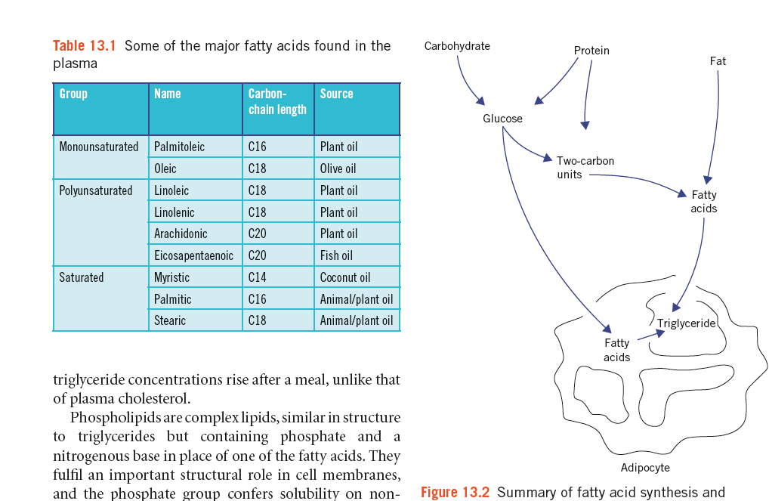

Slide 6
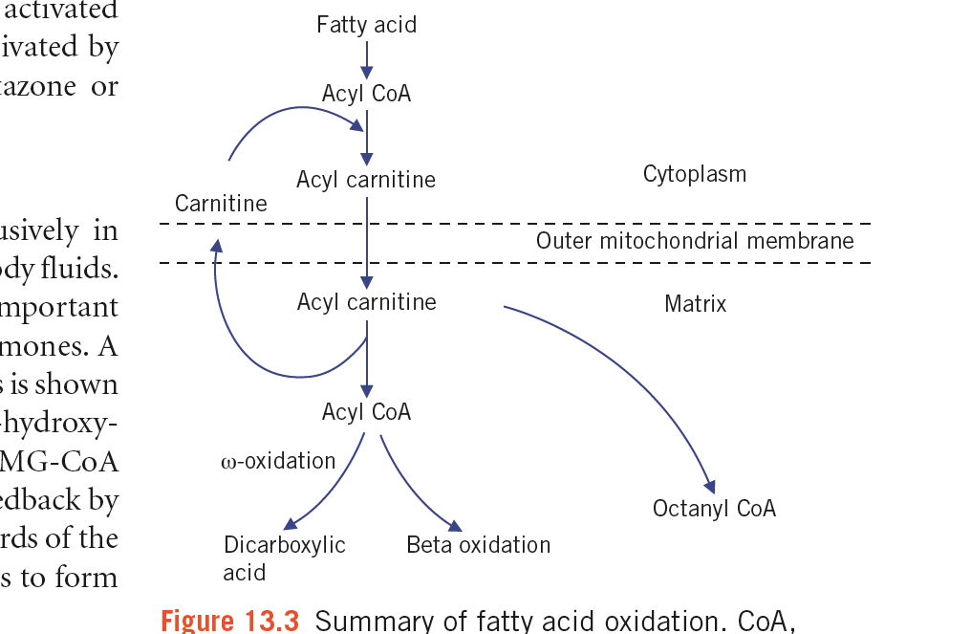

Slide 7
LIPIDS ARE TRANSPORTED IN THE PLASMA AS LIPOPROTEINS
Plasma lipids consist of triacylglycerols (16%), phospholipids (30%), cholesterol (14%), and cholesteryl esters (36%) and a much smaller fraction of unesterified long-chain fatty acids (free fatty acids) (4%). This latter fraction, the free fatty acids (FFA), is metabolically
the most active of the plasma lipids.

Slide 8
Four Major Groups of Plasma Lipoproteins Have Been Identified
(1) chylomicrons derived from intestinal absorption of triacylglycerol and other lipids
(2) Very low density lipoproteins (VLDL, or pre-β-lipoproteins), derived from the liver for the export of triacylglycerol
(3) low-density lipoproteins (LDL, or β-lipoproteins), representing a final stage in the catabolism of VLDL
(4) high-density lipoproteins (HDL, or α-lipoproteins) (reverse cholesterol transport system)

Slide 9
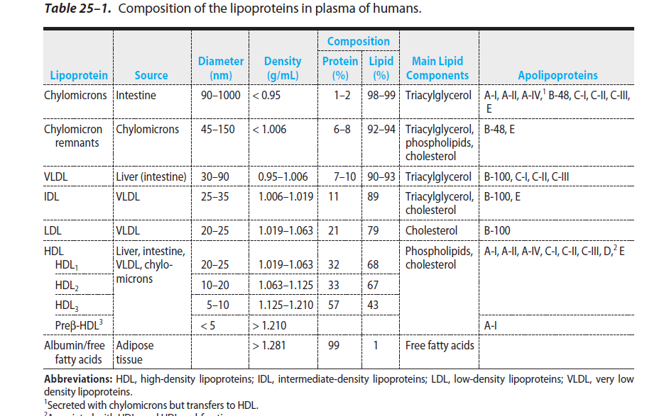

Slide 10
Lipoproteins Consist of a Nonpolar Core & a Single Surface Layer of Amphipathic Lipids

Slide 11
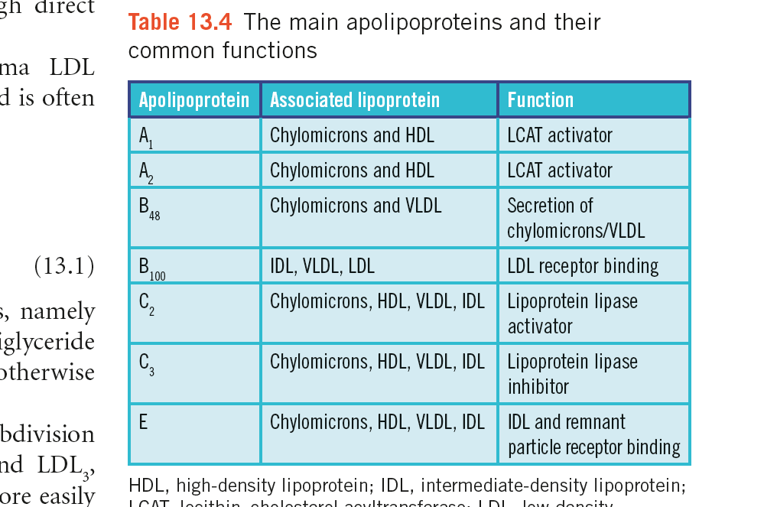

Slide 12
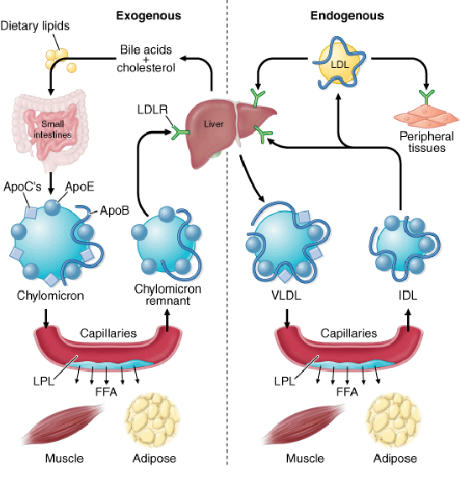

Slide 13
Reverse cholesterol transport pathway

Slide 14
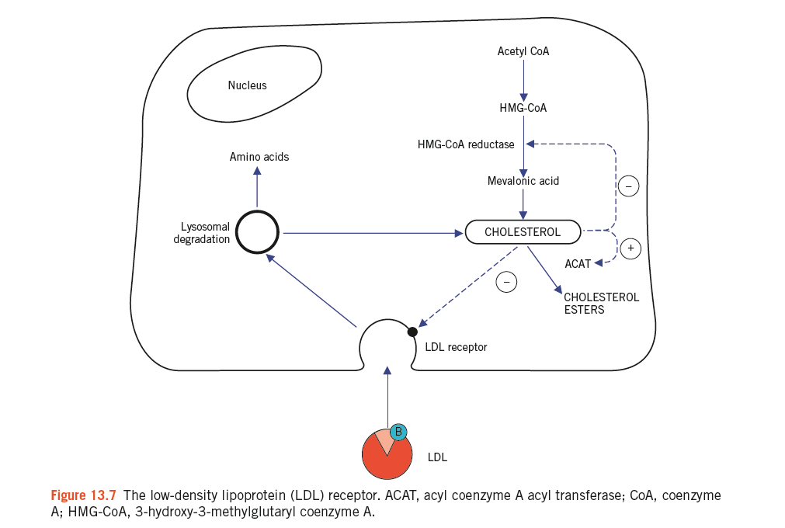

Slide 15
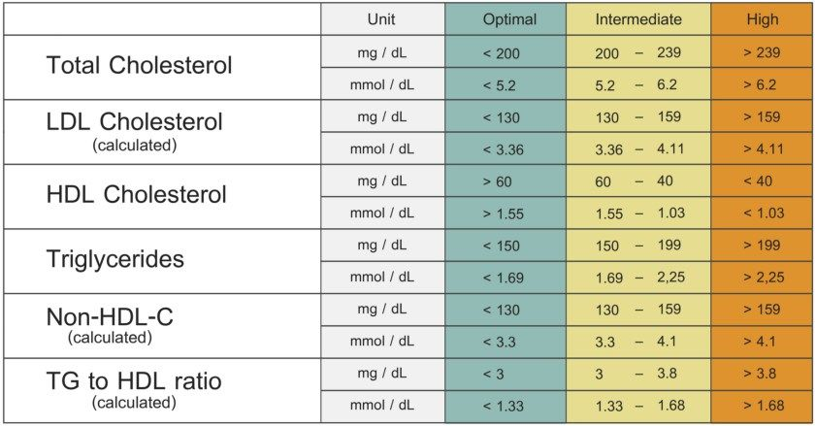

Slide 17
Calculated LDL
The Friedewald equation enables plasma LDL
cholesterol concentration to be calculated and is often
used in clinical laboratories:
LDL cholesterol (VLDL)
= total cholesterol – HDL cholesterol – [triglyceride/2.2]
This equation makes certain assumptions, namely
that the patient is fasting and the plasma triglyceride
concentration does not exceed 4.5 mmol/L (otherwise
chylomicrons make the equation inaccurate).

Slide 18
